Slide 1
The Endocrine System
Medicines for bone disorders
Ken Wojcikowski
PhD, Pharmacology, UQ School of Medicine

Slide 2
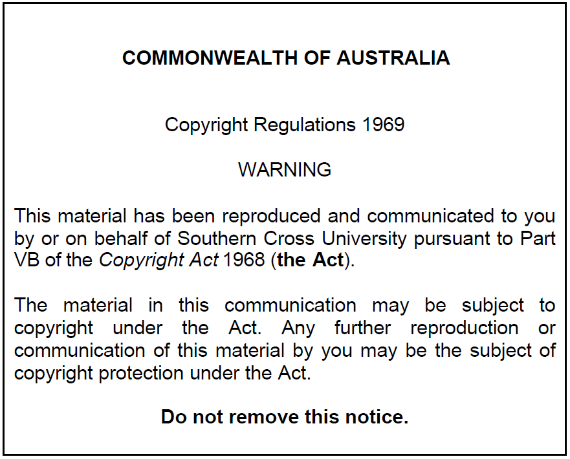
The endocrine system:
Medicines for bone disorders

Slide 3
Objectives for Endocrine System: Bone Disorders
  Explain the effects of parathyroid hormone and calcitonin and their role in bone health.
  Explain the process of bone formation and reformation
  Using two specific examples (bisphosphonates and teriparatide), explain how pharmaceutical agents can be beneficial for people with bone loss. Explain the main adverse drug reactions of these medications.

Slide 4
PHAR2001_2_5_1
kjhkjhlkdfs
Medications of the Endocrine System: Medications for bone disorders
Lesson 1:
Understanding Bone Health

Slide 5
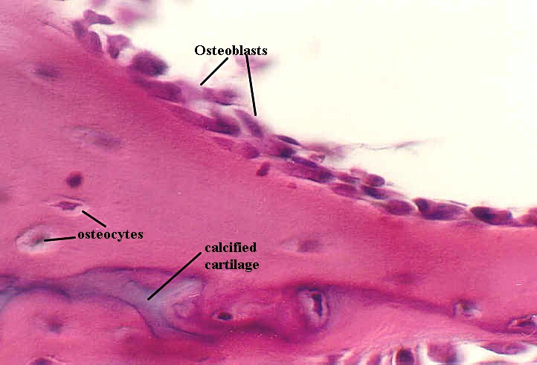

Slide 6
Bone health: Key cells and hormones
The balance between osteoblast and osteoclast activity is important
Osteoclasts
  Digests the bone
  Secrete cytokines that stimulate resorption
  One small section of bone at a time
Osteoblasts rebuild the bone
Bone formation and breakdown involves participation of the hormones from the parathyroid gland and the hormone commonly referred to as vitamin D

Slide 7
Factors that contribute to osteoporosis
Constitutional | Disease & drugs | Lifestyle
Female | hyperthyroidism | Smoking
Age | hyperparathyroidism | Physical inactivity
Post menopause | Cushing’s | Low calcium and vitamin D intake
Slight body build | Malabsorption syndromes.
Late menarche | Corticosteroids
 | Androgen deprivation therapy
 | Glitazones
 | (Drugs that increase the falls risk)

Slide 8
PHAR2001_2_5_1
kjhkjhlkdfs
Medications of the Endocrine System: Medications for bone disorders
Lesson 2:
Understanding Bone Health

Slide 9
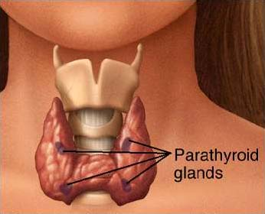

Slide 10
PTH: The hormone of the parathyroid gland
Parathyroid Hormone (PTH)
Increased release in response to decreased serum calcium levels
Increases osteoclastic activity
Liberates free calcium
Decreases excretion of calcium by the kidneys
Calcitonin is released from the thyroid gland
Responds to high serum calcium
Inhibits osteoclastic activity and formation

Slide 11

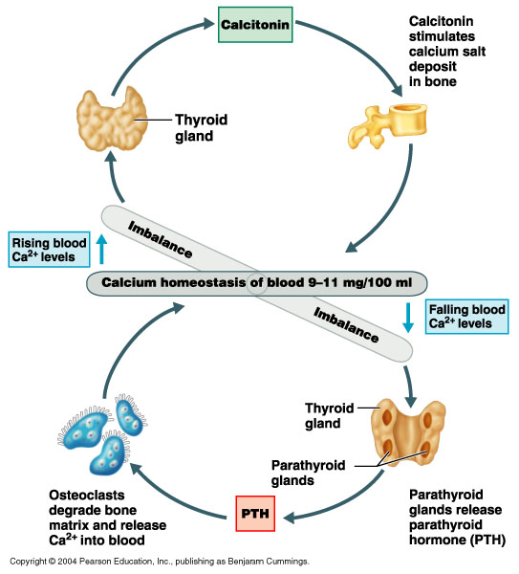

Slide 12
Marieb EN et al. Human Anatomy and Physiology 6th ed. Pearson Education

Slide 14
Parathyroid gland secretes PARATHYROID HORMONE (PTH)
(Stimulated by low levels of calcium)
Increases the synthesis of vitamin D
Releases calcium from bone
Decreases renal excretion of calcium
Increases absorption of calcium in the intestines

Slide 15
Important bone disorders
Osteoporosis
  Decreased bone mass and density
Osteomalacia and Rickets
  Softening of the bones due to decreased mineralisation
  Most commonly caused by inadequate Vitamin D
Osteonecrosis
  Cellular death of bone cells due to inadequate blood supply
Paget’s disease
  Abnormal enlargement and weakening of the bone

Slide 16
Glucocorticoid induced bone disease
Leading cause of secondary & iatrogenic osteoporosis.
Lumbar spine & proximal femur.
2 phases:
  6-12% loss in first year.
  3% loss pa thereafter.
  Rapid increase in risk of hip and vertebral fracture.
  Fracture risk increases by 75% in first 3 months of treatment before a decline in BMD.
Osteonecrosis may be as high as 40% of patients
  Osteonecrosis is death of bone due to decreased blood supply
NEJM 2011; 365:62-70

Slide 17
Prevention of osteoporosis
Calcium and vitamin D supplements.
  Reduce rate of bone loss.
  Vitamin D 1000iu/day.
No calcium supplements after about 50 y/o due to increased risk of MI
Exercise, especially weight bearing exercise before the age of 30

Slide 18
PHAR2001_2_5_1
kjhkjhlkdfs
Medications of the Endocrine System: Medications for bone disorders
Lesson 3:
Bisphosphonates, Teriparatide and SERMs

Slide 19
Treatment of osteoporosis
First Line:
  Oral Bisphosphonates
    Inhibit bone breakdown and resorption
    Selective localisation and prolonged storage in bone
    Increase BMI in the femoral neck and lumbar spine.
  Osteonecrosis of the jaw.

Slide 20
Oral bisphosphonates
(The first ‘s’ is normally silent)
Oral bisphosphonates end in …dronate:
Alendronate (Fosamax)
Risedronate (Actonel)
Pamidronate (Aredia)
Zoledronate (Zometa, Aclasta)

Slide 21
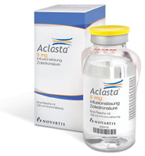
Other treatments for osteoporosis
Intravenous bisphosphonates
  IV Zoledronic acid
    Once yearly infusion
    Rapid skeletal protection

Slide 22
Other treatments for osteoporosis
Selective oestrogen receptor modulators (SERMs)
  …oxifene medications like raloxifene, tamoxifen, and lasofoxifene
    Agonist at the bone (acts like oestrogen at the bone
    Antagonist at the breast, ovary (blocks the oestrogen in the areas associated with oestrogen related cancers)

Slide 23
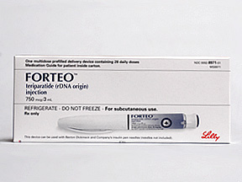
Other treatments for osteoporosis
  Teriparatide, the only anabolic treatment
    Recombinant human parathyroid hormone; identical to a portion of human PTH
    Intermittent use activates osteoblasts more than osteoclasts
    It is effective in growing bone (8% increase in bone density in the spine after one year)
    Daily s/c injection
    Osteosarcoma??
    Hypercalcaemia.

Slide 24
References
Thibodeau GA, Patton KT: Anatomy and Physiology 5th ed. Mosby, St. Louis 2003
Marieb EN et al. Human Anatomy and Physiology 6th ed. Pearson Education publishing as Benjamin Cummings 2004
Patton KT, Thibodeau GA: Mosby’s Handbook of Anatomy and Physiology Mosby, St. Louis 2006
Royalty free images from Shutterstock
The PowerPoint and associated Video were edited and produced by Dr. Ken Wojcikowski

